Slide 1
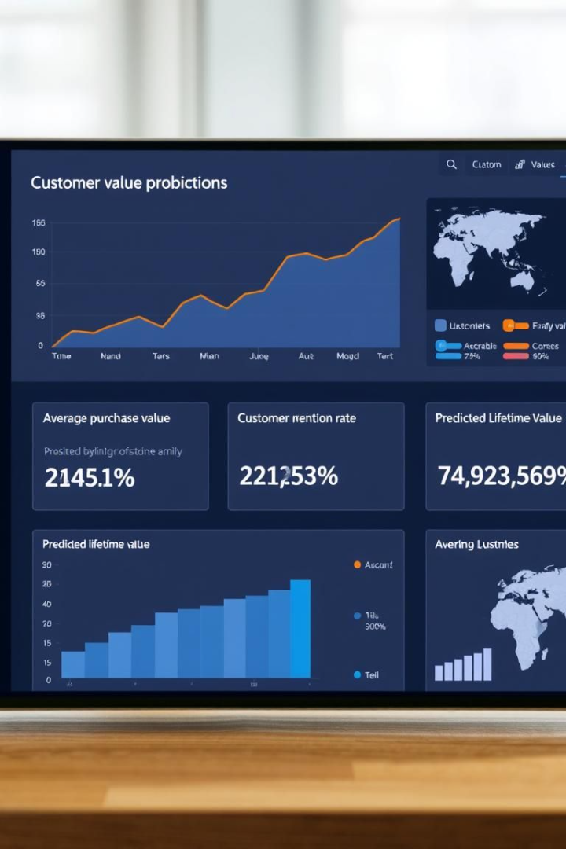
Unlocking Growth: Customer Lifetime Value (CLV) Prediction
Discover how predictive analytics can drive strategic decisions. Maximize ROI with targeted marketing and resource allocation. Understand the true value of your customer relationships and unlock sustainable growth.

Slide 2
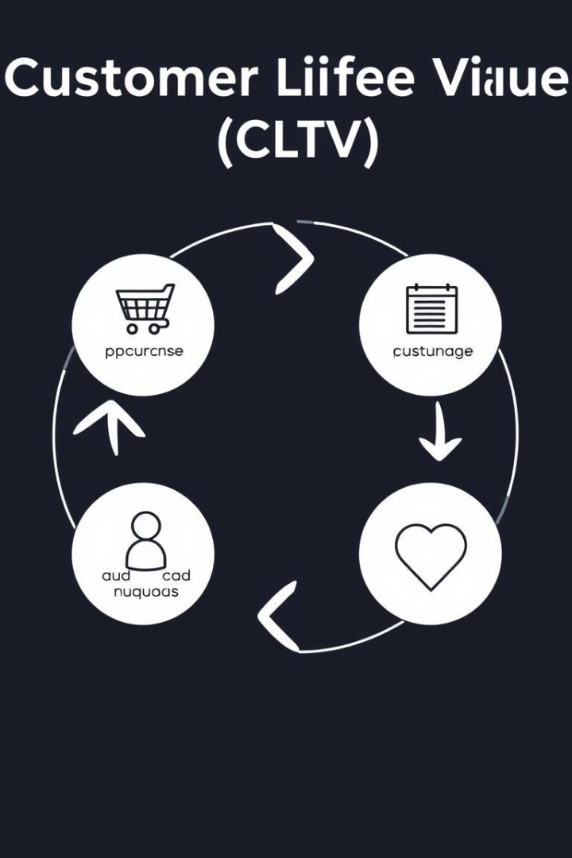
What is Customer Lifetime Value (CLV)?
CLV is the prediction of net profit attributed to the entire future relationship with a customer. A subscriber who pays $50/month for 3 years has a CLV of $1800. Key metrics include retention and churn rates.
Average Purchase Value
Purchase Frequency
Customer Lifespan

Slide 3




Why Predict CLV?
Predicting CLV allows for improved customer segmentation. It also helps optimize marketing spend and resource allocation. Further, high-value customers can be identified and nurtured to increase loyalty.
Improve Segmentation
Optimize Spending
Nurture Loyalty
Increase customer segmentation and personalization.
Optimize marketing spend and resource allocation.
Identify high-value customers and nurture loyalty.

Slide 4





Technologies used
Various technologies are involved. These include front end languages, back end frameworks and Data manipulation languages.
HTML
CSS
Python
Machine Learning

Slide 5




Data Requirements for CLV Prediction
Transaction and demographic histories are critical. Website activity and customer service interactions are also important. Accurate and complete data is essential for reliable CLV predictions.
Transaction History
Purchase dates, amounts, products.
Demographic Data
Age, location, income.
Website Activity
Page views, clicks, time on site.

Slide 6
CLV Prediction Models: A Comparison
Several models can be used for CLV prediction. Simple averages are easy to implement, but have low accuracy. Machine Learning (ML) models are advanced and improve prediction accuracy.
Simple Average
Cohort Analysis
Regression Models
Machine Learning (ML) Models
Easy to implement, low accuracy.
Provides insights into customer lifecycle.
Requires statistical expertise.
Requires technical expertise, high accuracy.

Slide 7
Implementing CLV Prediction: A Step-by-Step Guide
Define clear objectives and gather relevant customer data. Clean the data and choose an appropriate model. Train and validate the model, then monitor its performance.
1
Gather Data
2
Select a Model
3
Train Model

Slide 8



Conclusion: The Future of CLV Prediction
CLV prediction empowers data-driven decision-making. Advanced analytics provide a competitive advantage. Embrace CLV to build stronger customer relationships and drive sustainable growth.
2
Competitive Advantage
Data-Driven Decisions
1
Stronger Relationships
3

Slide 9
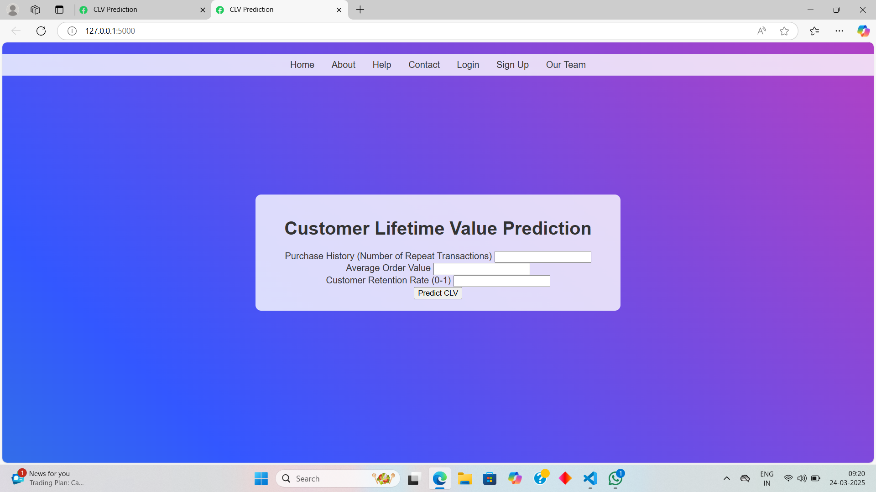
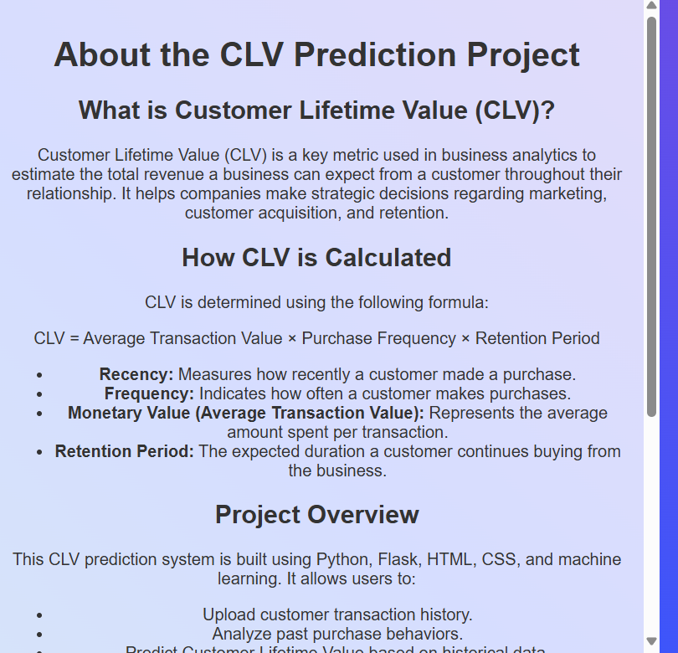
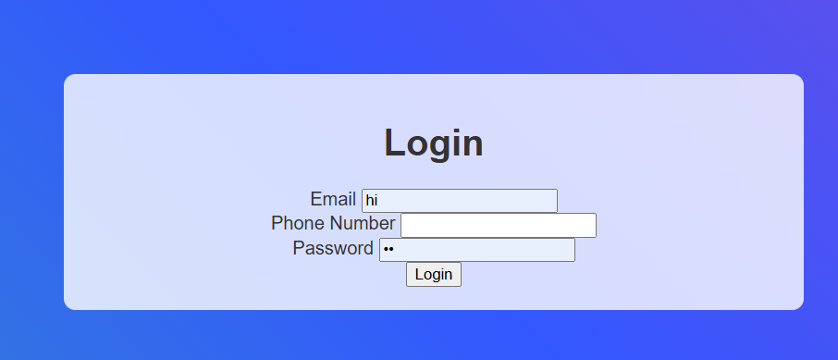

Slide 10
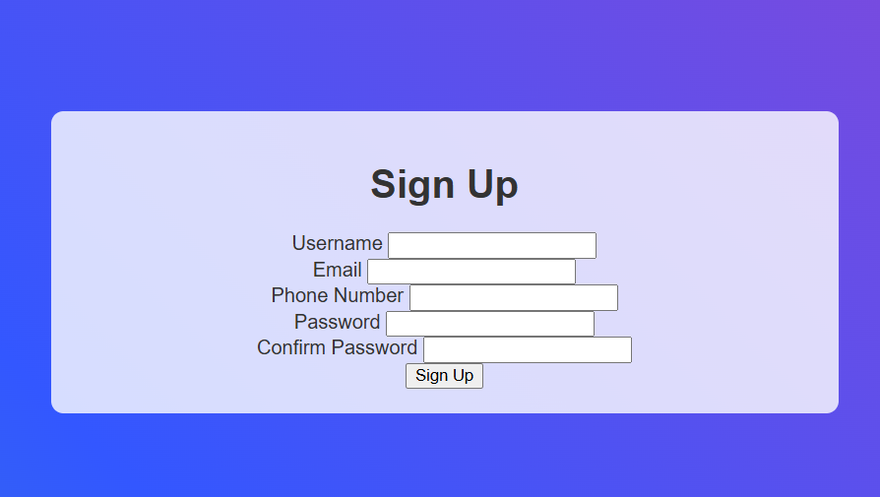
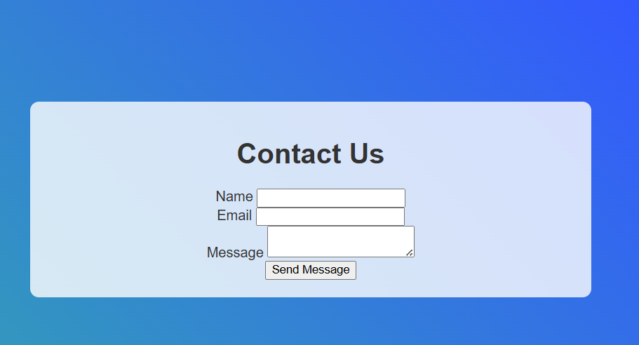
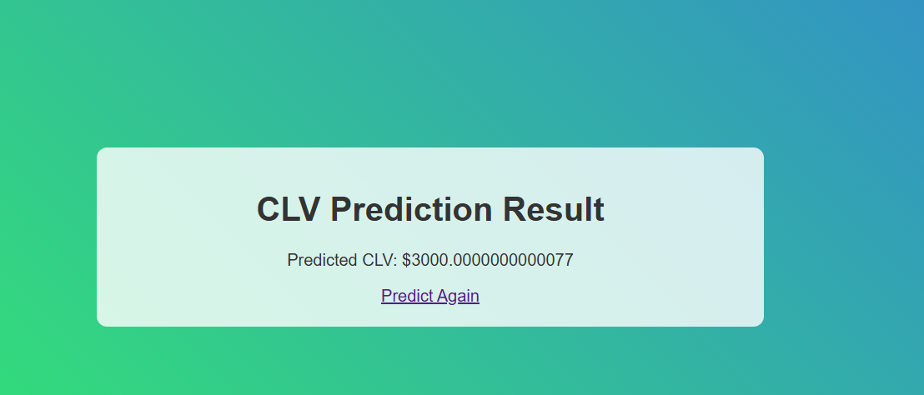

Slide 11
